Slide 1
Dynamic Deliveries
Restaurant delivery website
Consolidation of restaurants across multiple platforms
GrubHub
DoorDash
UberEats
Shopping cart
Django
Data mining
Python
BeautifulSoup
Security
Https
Django
UI
Bootstrap

Slide 2
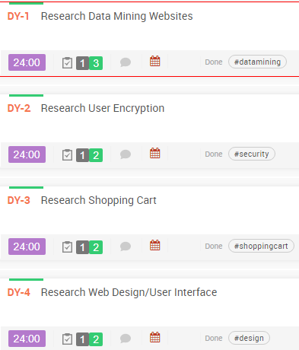
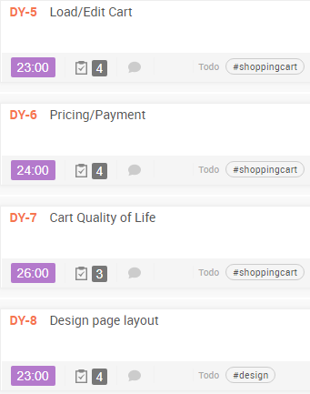
Stories

Slide 3
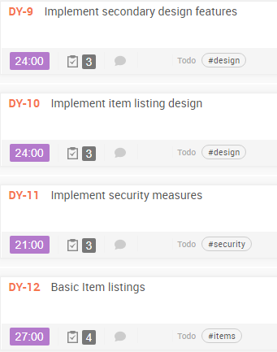
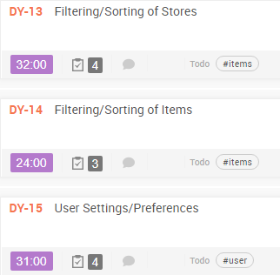
Stories

Slide 4
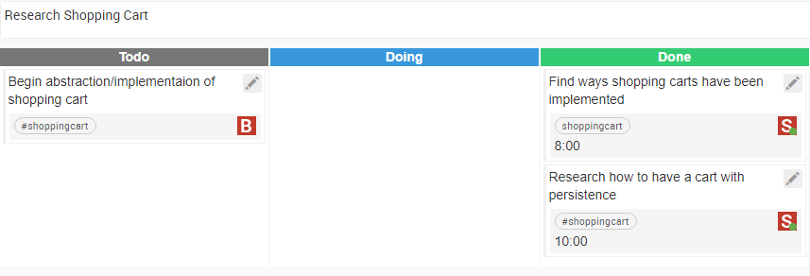
Tasks

Slide 5
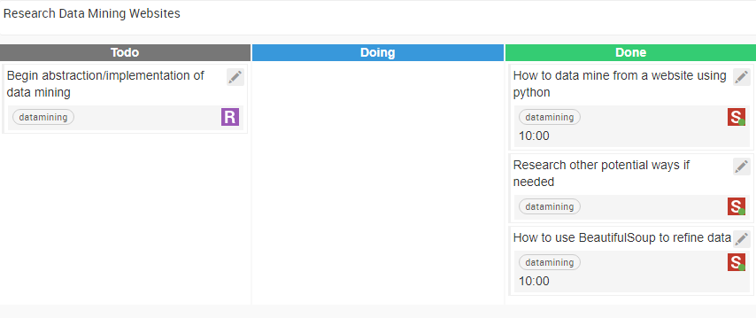
Tasks

Slide 6
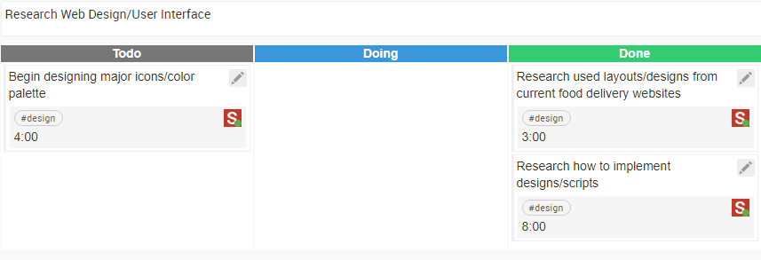
Tasks

Slide 7
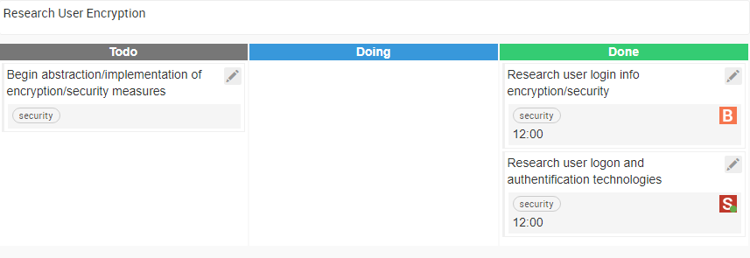
Tasks

Slide 8
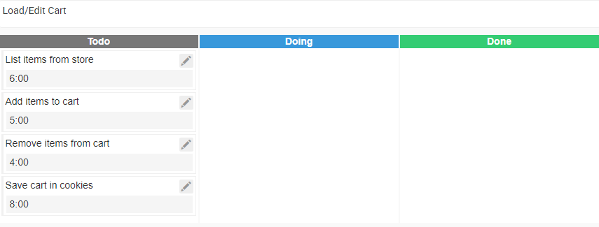
Tasks

Slide 9
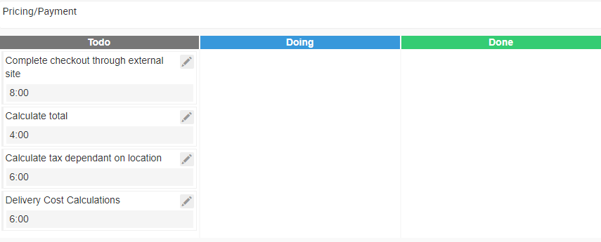
Tasks

Slide 10
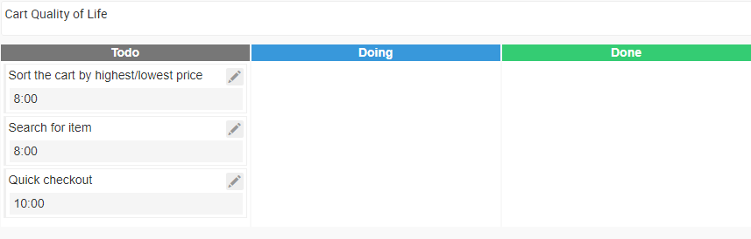
Tasks

Slide 11
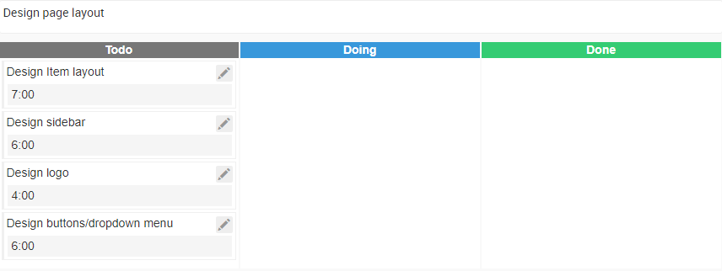
Tasks

Slide 12
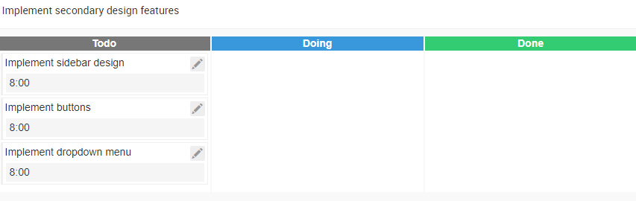
Tasks

Slide 13
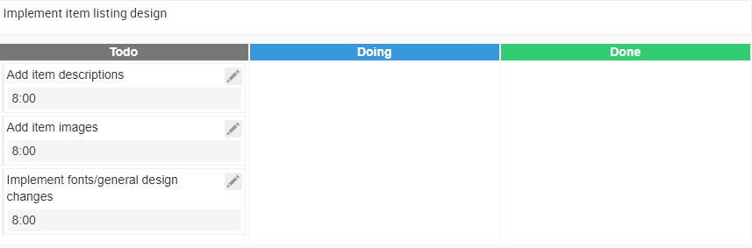
Tasks

Slide 14
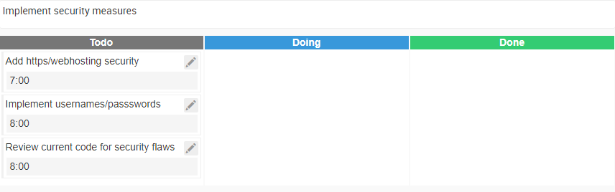
Tasks

Slide 15
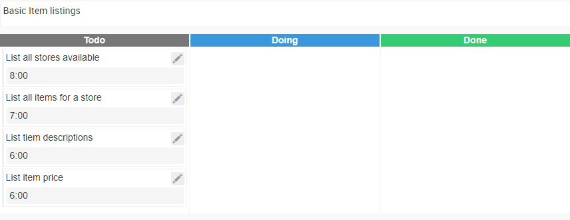
Tasks

Slide 16
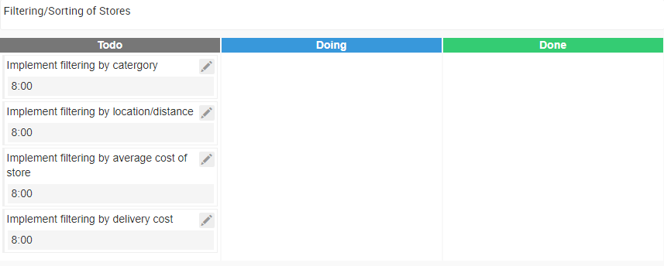
Tasks

Slide 17
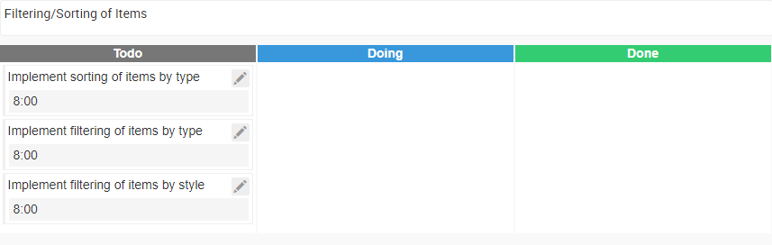
Tasks

Slide 18
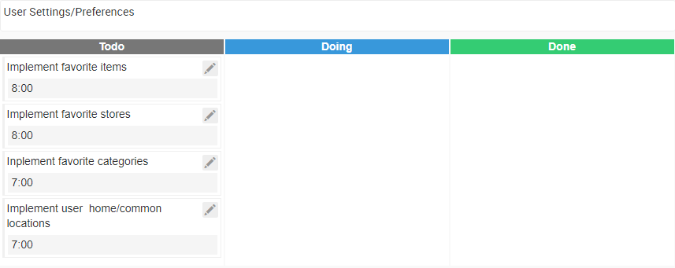
Tasks

Slide 19
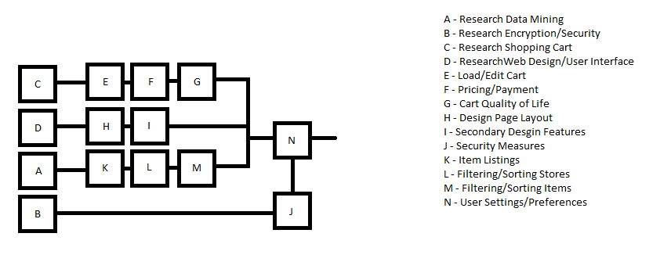
Activity Network

Slide 20
Risks
Loss of team members
Low
Unable to mine data
High
Planned system is too large
Medium
Loss of time
Medium
Software has low quality
Low

Slide 21
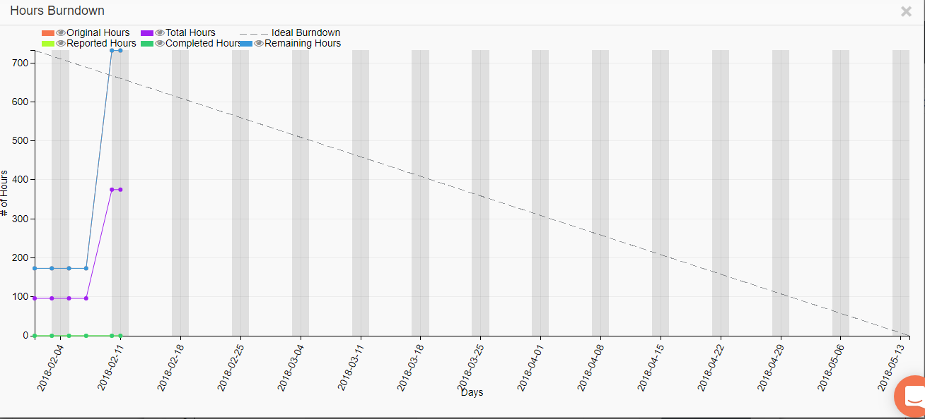
Burndown

